Slide 1
Suicide and Health Expenditure Is there are a relationship between how much countries spend on health and suicide rates?
Justin Field, Sherry Javid and Shona Critch

Slide 2


Slide 3
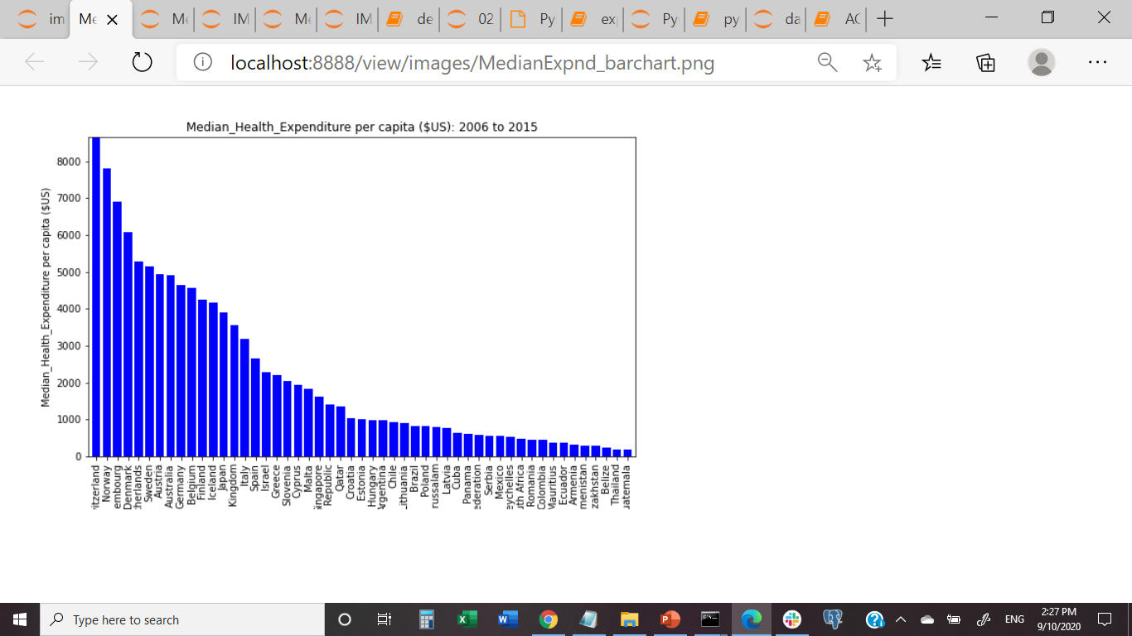
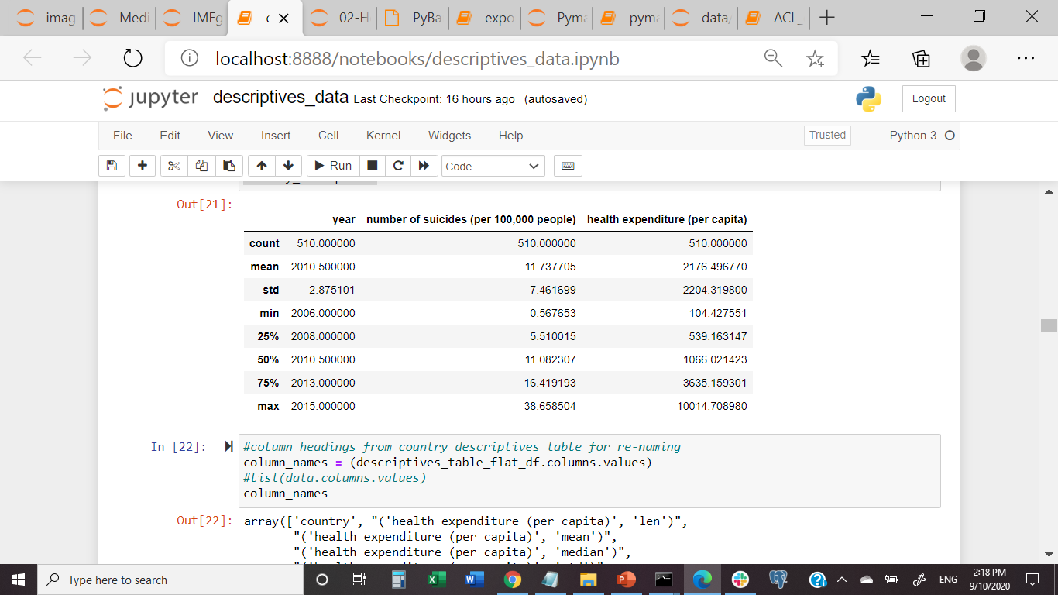
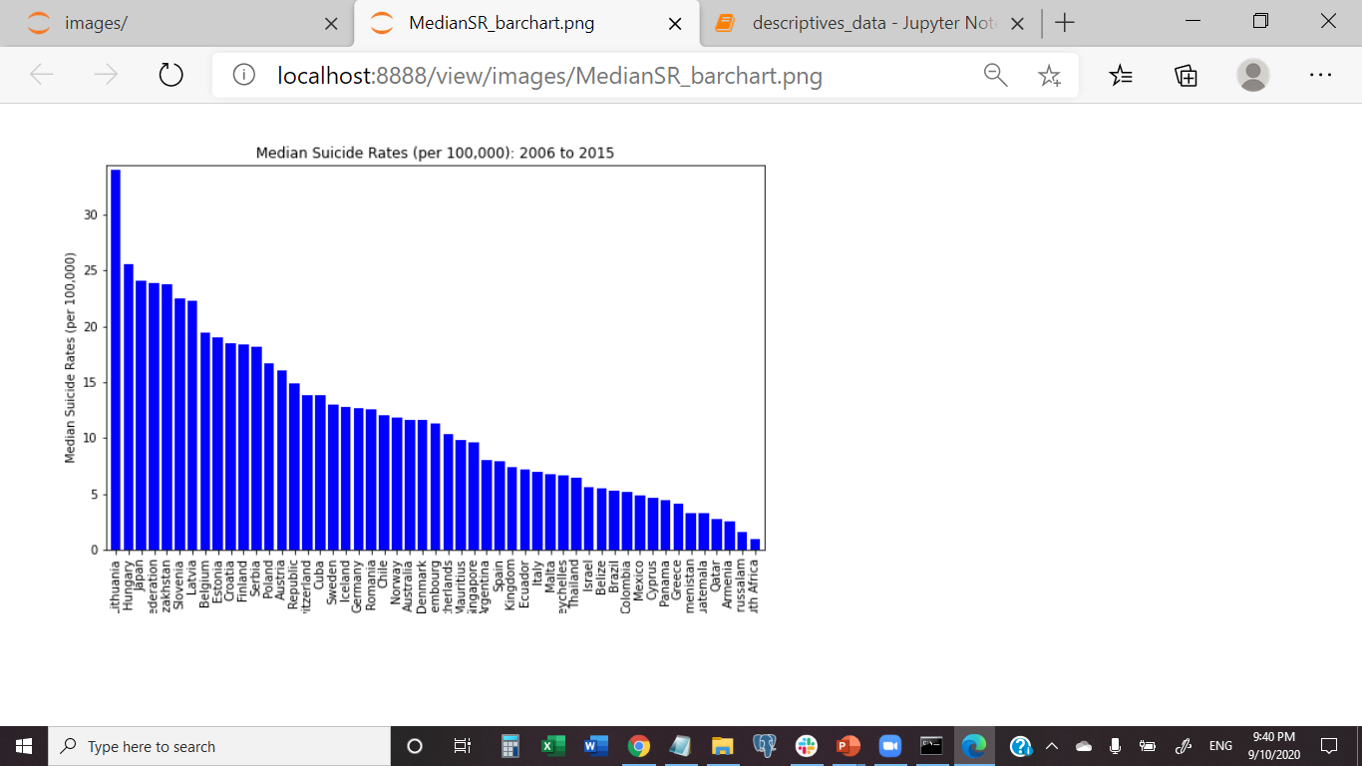
What does the data describe?
Health Expenditure Medians by Country : 2006 to 2015
Developed?
Developing?
Suicide Rate Medians by Country: 2006 to 2015
Lithuania

Slide 4
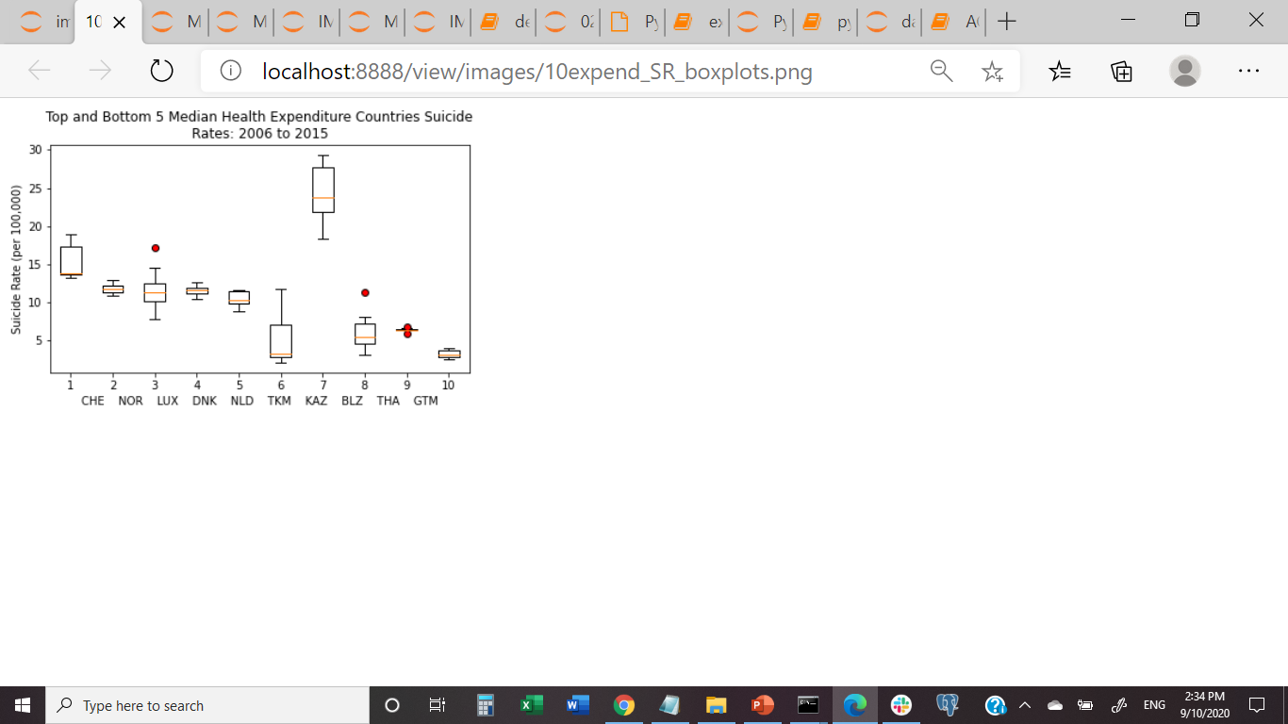

How similar are the top and bottom 5 countries?

Slide 5
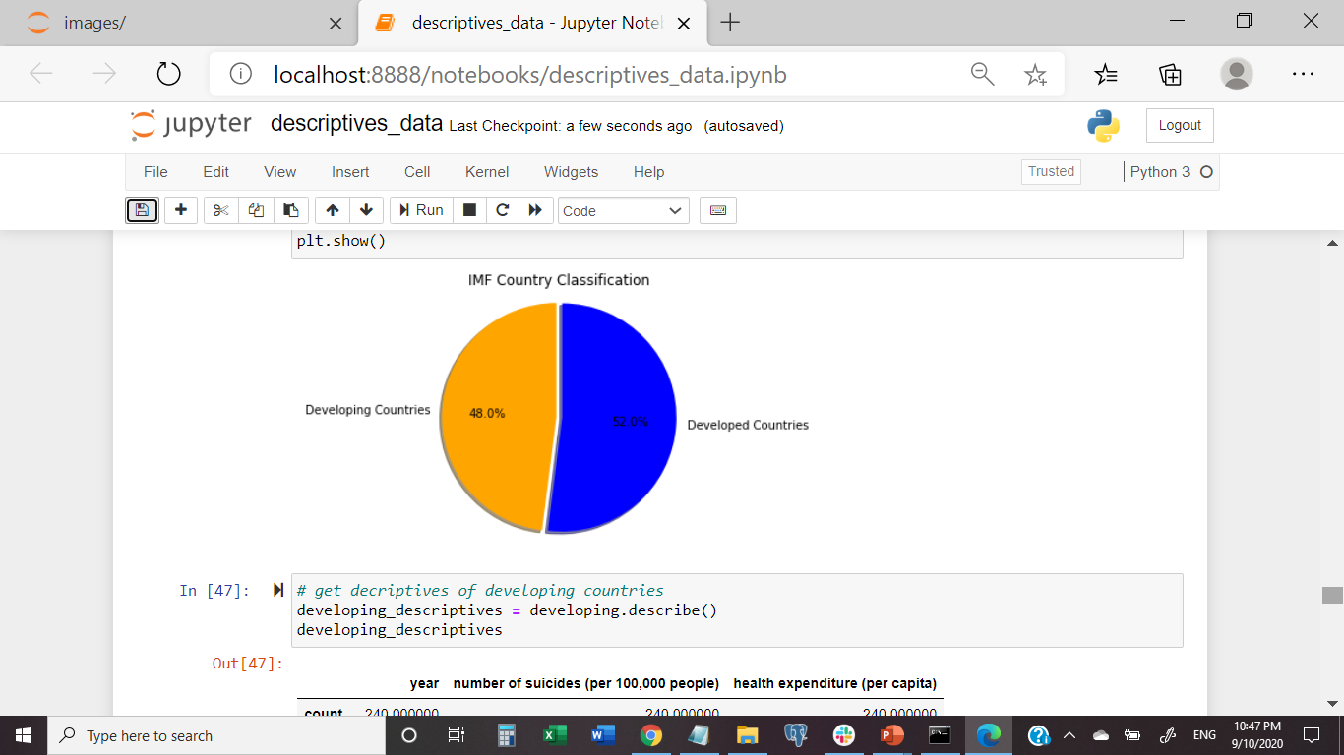
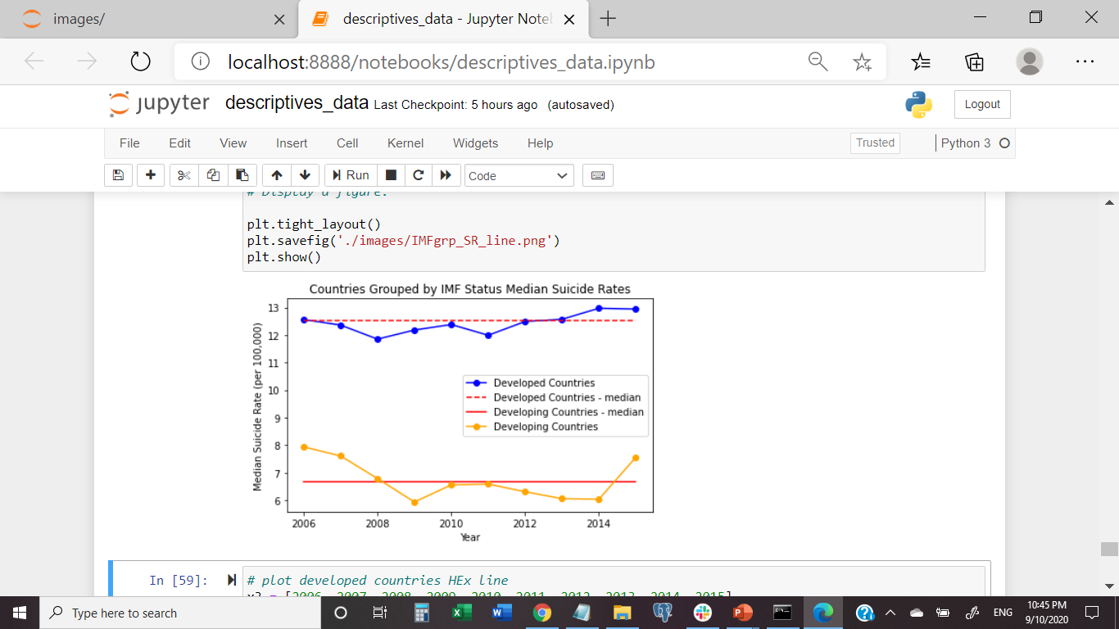
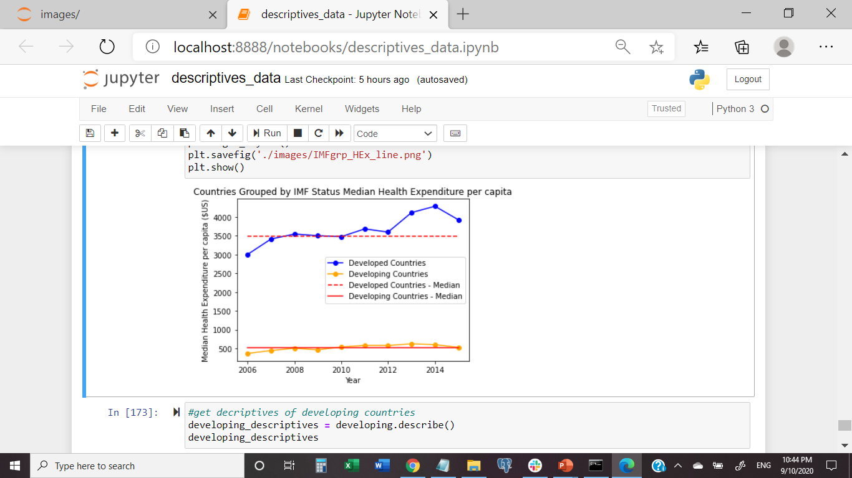
What about IMF groups and over time?
Developed =Higher suicide rate of the two groups, and increasing spend on health
Developing = lower and more variant
Median suicide rates and steady low spend

Slide 6
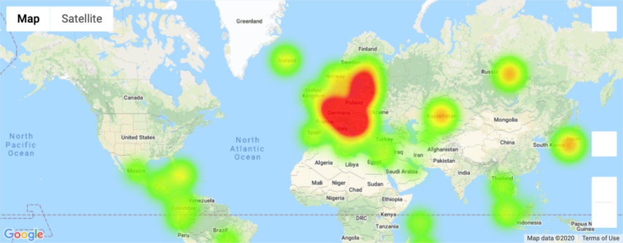
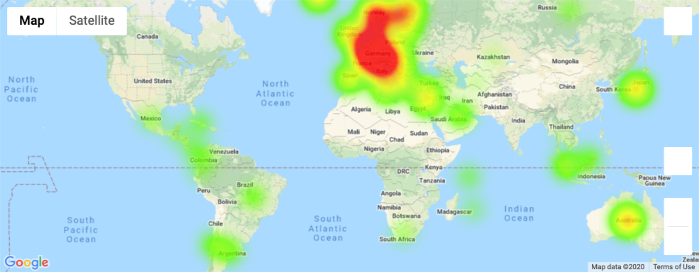
Median Health Expenditure (Left) VS Median Suicide Rate (Right)

Slide 7
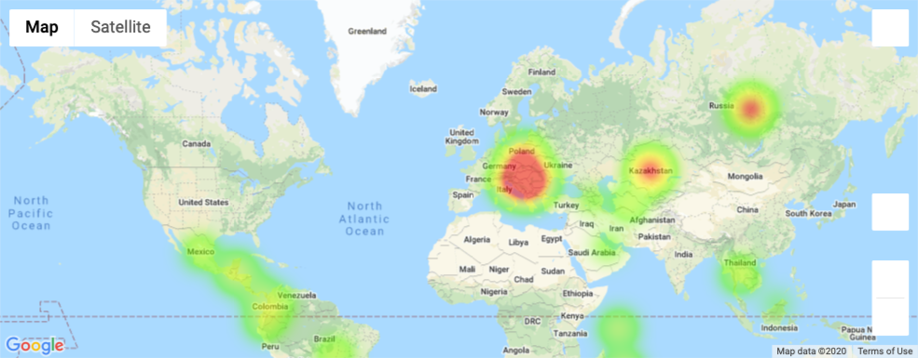
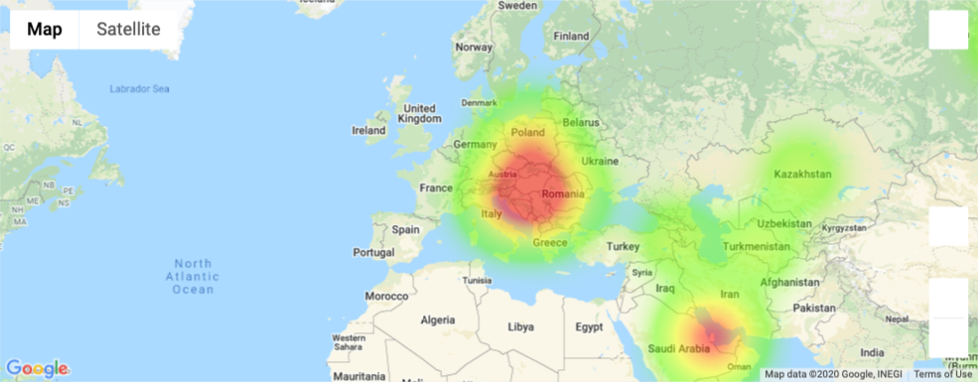
– Developing countries
(Health expenditure (per capita) (Left)
vs
Number of suicides (per 100,000 people) – developing (Right)

Slide 8
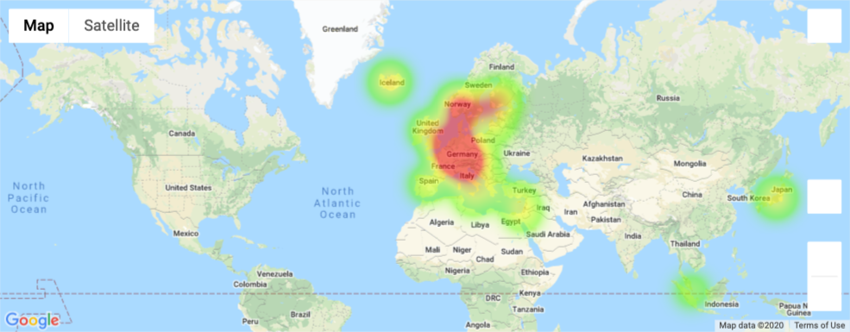
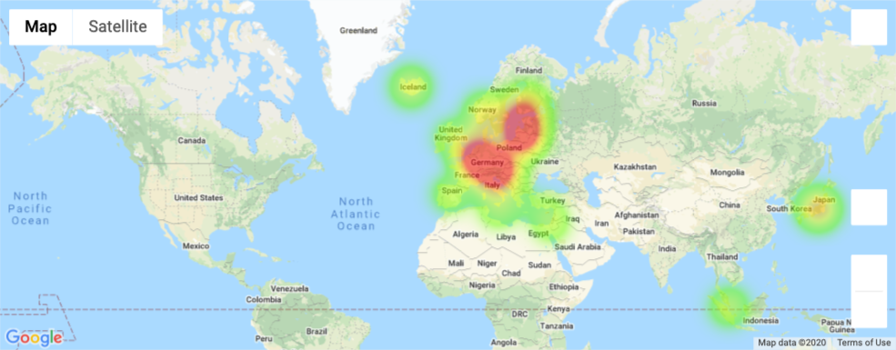
Developed countries
Health expenditure (per capita)
VS
number of suicides (per 100,000 people)

Slide 9
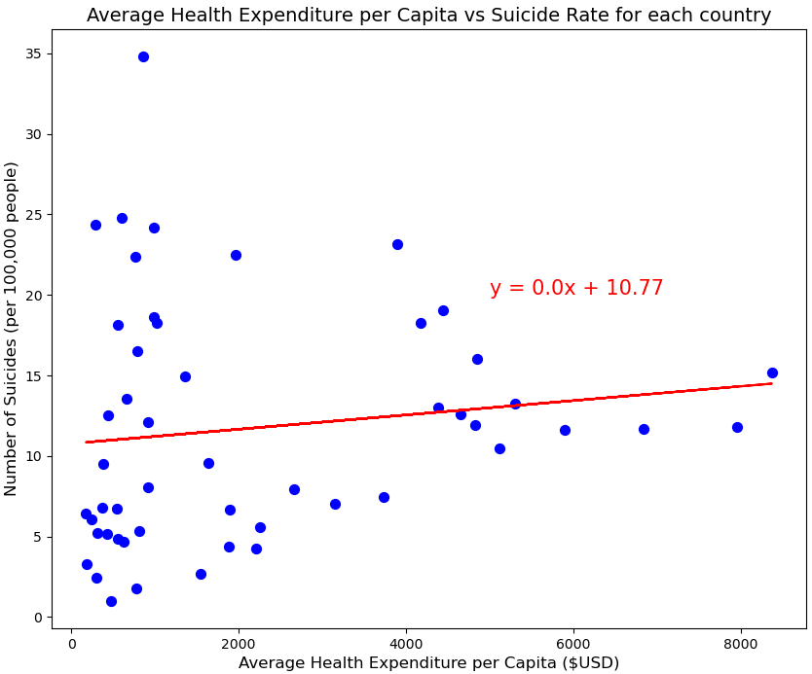
Linear Regression Analysis – Complete Dataset
r = 0.132
r²= 0.0173

Slide 10
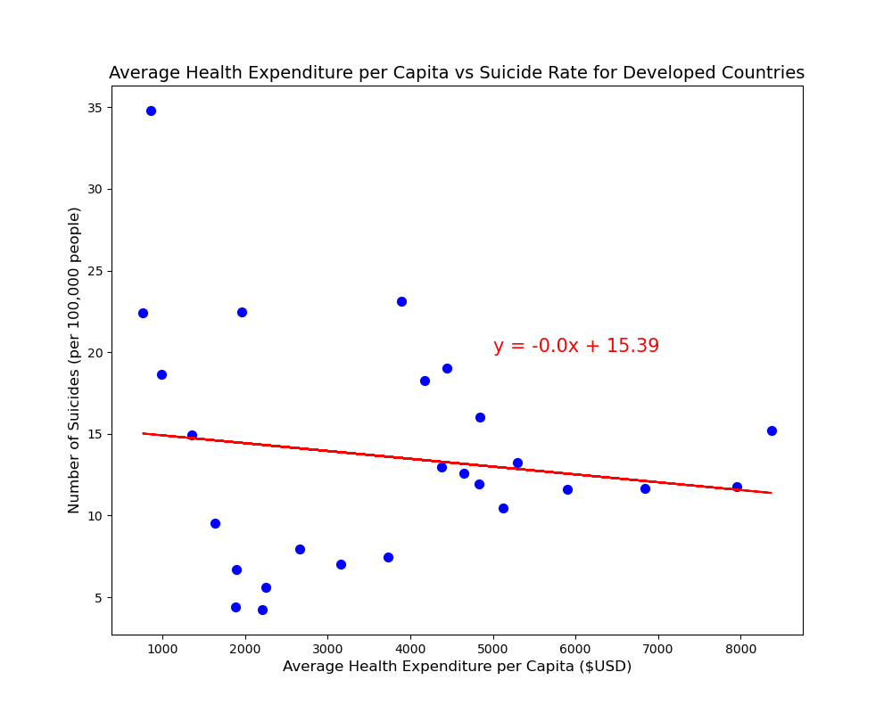
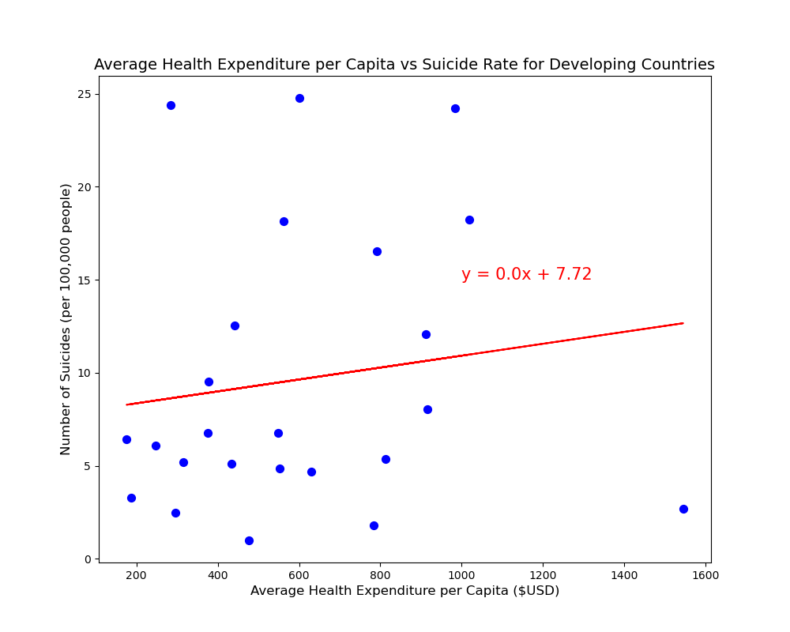
Linear Regression Analysis – Country Subsets
Developed Countries
Developing Countries
r = -0.146
r²= 0.0211
r = 0.139
r²= 0.0194

Slide 11

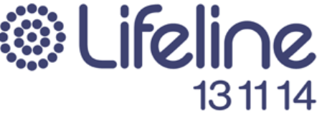
Questions?

